Slide 1

What drives rents in New Zealand
Joint research paper with Treasury and RBNZ
July 2023

Slide 2
Why should we care about rents?
Notes:
Media queries and OPQ

Slide 3
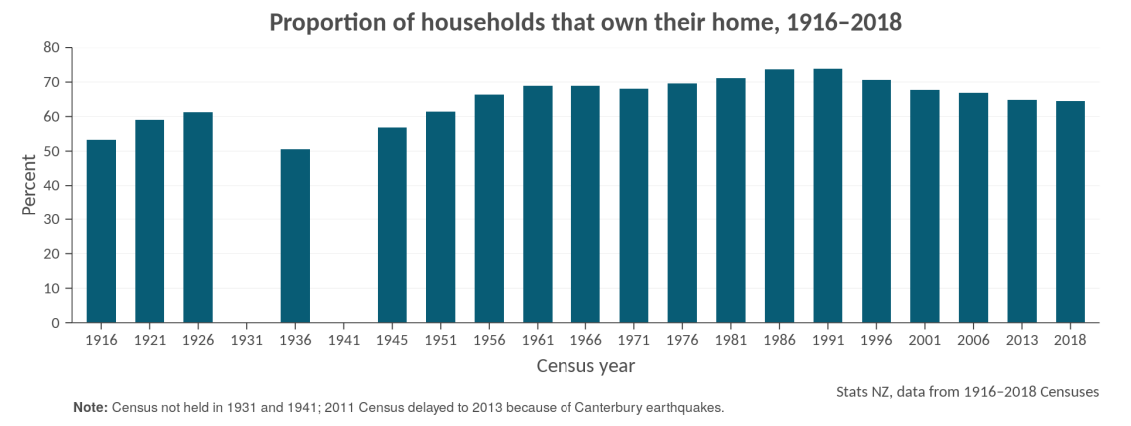
More people are renting (privately)
Notes:
Especially since the early 1990s. From Census 2018, out of all households that rent, 4 out of 5 rent privately

Slide 4
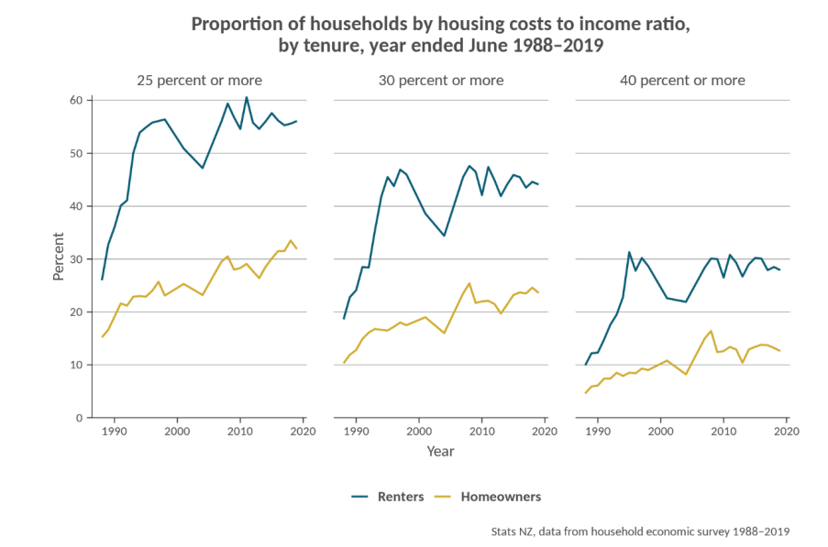
Better understanding of rent drivers can lead to better policy as renters typically pay a larger proportion of their incomes on housing costs than owner occupiers and so are more vulnerable to large movements in housing costs

Slide 5
Rents can provide a better signal of the balance of supply and demand for dwellings than house prices
Rent prices reflect the “true” price/cost of housing services consumption
Rent prices do not include expectation of future gains like house prices do

Slide 6
Forecasting rents can also improve the accuracy of house price forecasts
They are one of the factors that influence house prices
Excluding debt servicing/maintaining cost and expected capital gains, house prices should equal to the net present value of rents
Treasury are now planning to incorporate the finding into their rent and subsequently house prices forecast
Notes:
RBNZ’s user cost model People should be indifference between renting and owning
Think of owning a house as paying rents to yourself over however long you are owning it

Slide 7
The framework helps us to understand how land and housing markets operate.
The recent HTWG’s assessment of the housing system concludes that the land market in NZ is restricted to some degree
Underpinning this is the assumption that interest rates impact house price but not rents
We want to test this hypothesis explicitly
Notes:
Ham-Wai paper

Slide 8
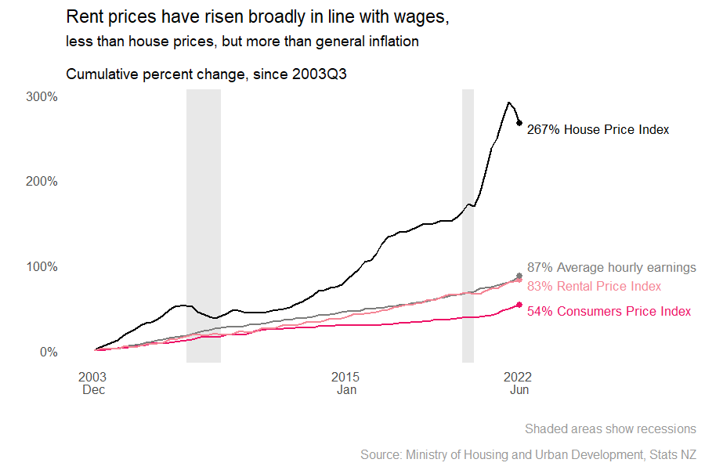
The framework helps us to understand how land and housing markets operate.

Slide 9
Why did we want to do this research
In theory, there are many factors that can impact rents
We want to know what impact rents the most and by how much, e.g if wages increase by 1 percent, how much can we expect rents to increase, if everything else stay the same
Notes:
Not always realistic, but provide us with a framework for our advice

Slide 10
Potential factors
Wages
Physical supply and demand of dwellings (measured by people per dwellings)
Mortgage (interest) rate
General inflation
Unemployment rate/job security
House price
Notes:
Wage: Renters ability to pay
Supply/demand: Availability of rental properties
Mortgage rate: first home buyers may delay buying due to rising mortgage unaffordability, increasing demand for rental property. Higher financing cost reduces supply response. As supply increase, yield decrease so banks are less likely to lend to develop
Unemployment: Job security and household formation. Better job security can encourage people to form new and smaller households, which in turn, increases the demand for rental properties. For example, young adults may be more inclined to leave the family home when unemployment is low. Secondly, a strong labour market and positive economic outlook would ensure tenants’ current and future ability to pay, allowing landlords to raise rents
Any other impact that are not included in wages
House price: unobserved region-specific factors act on the housing market as a whole, rather than just the rental market. in a falling market time to sell would be expected to increase which may lead to an increase in the rental stock, and therefore downward pressure on prices.

Slide 11
Key findings
Wage inflation and relative supply and demand of dwellings (measured by people per dwelling) are the two key drivers of rent inflation for new tenancies at the national level.
Increasing mortgage rates increase rents and increasing unemployment decreases rents but the impacts are relatively weak compared with wages and dwellings supply and demand
The identified key drivers are robust to local circumstances, although unobserved region-specific factors can dampen or magnify the effects in particular regions.

Slide 12
Key findings in numbers
All else equal, a 1 per cent increase in nominal wages leads directly to 1 per cent increase in new tenancy rents
A 1 percent increase in people per dwelling (50k more people or 20k less dwellings), leads to a 1.5 percent increase in rents at the national level
Notes:
5 million people and 2 million dwellings

